Slide 1

Convolutional AutoEncoder
Performed by: EDABK team
Guided by : Assoc. Prof.Nguyen Duc Minh
1

Slide 2
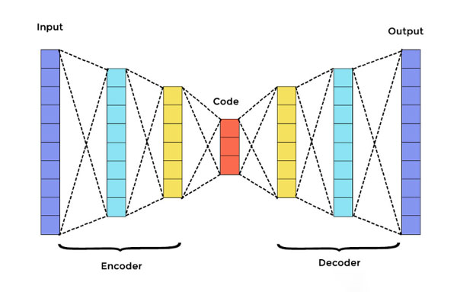
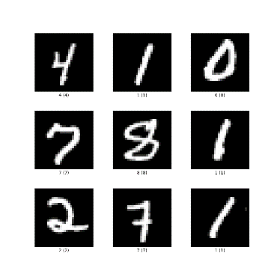


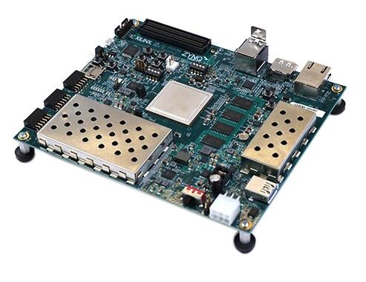
OVERVIEW
Convolutional Neuron Network
MNIST dataset
Output
ZCU 104
2

Slide 3

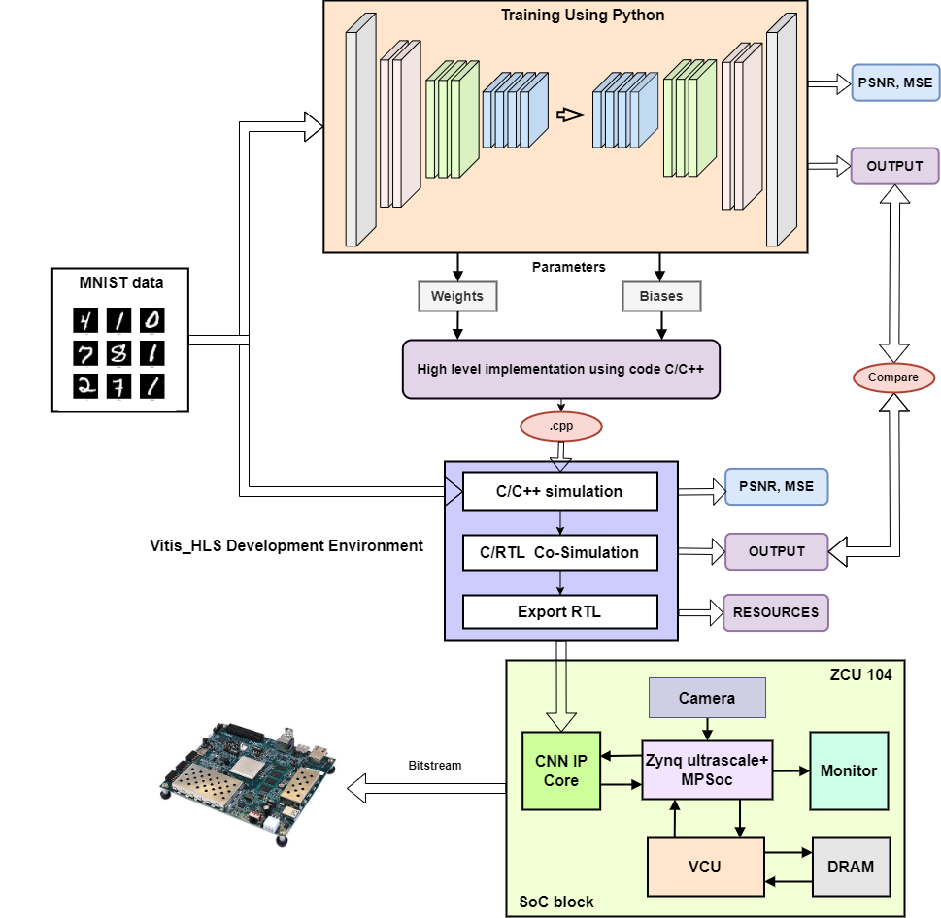
METHODOLOGY
3
Notes:
To know more about what we have done thí this project, let look in our Methodology . First ưe

Slide 4
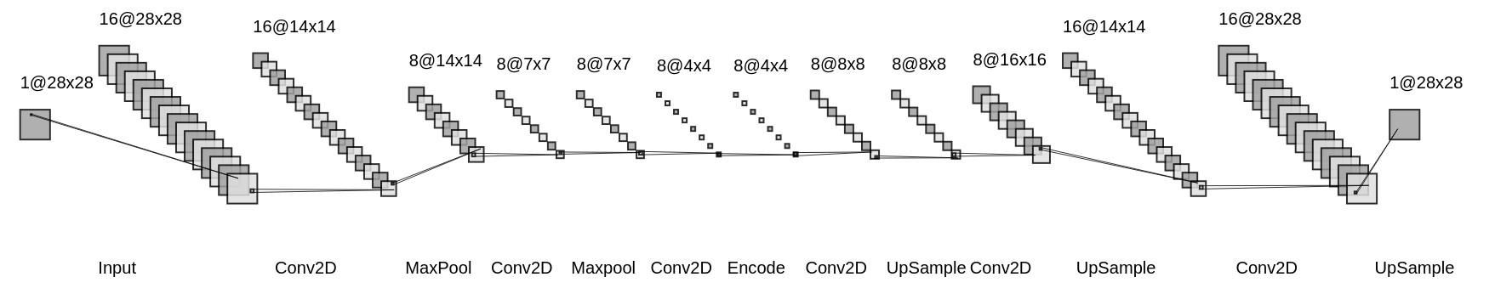
1
Convolutional Architecture
Result of CNN architecture with MNIST dataset
Model | Test PSNR (dB) | Parameters
Fully-connected neural layer | 54.12 | 50992
Deep autoencoder | 60.20 | 222384
Convolutional autoencoder (6Conv, 2MaxPool, 3UpSample) | 69.07 | 4385
CA (4Conv, 1MaxP, 2UpSamp) | 58.42 | 3272
CA (8Conv, 3MaxP, 4UpSamp) | 70.54 | 12547
Python block
4

Slide 5
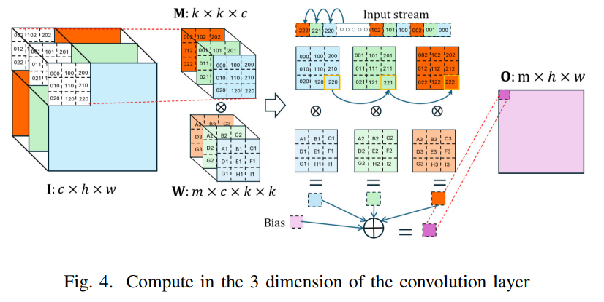
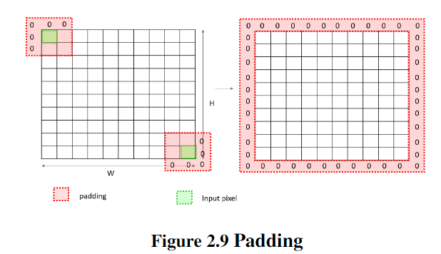
1
Convolutional Architecture
4

Slide 6
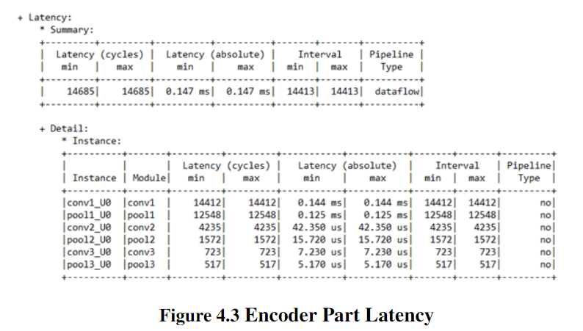

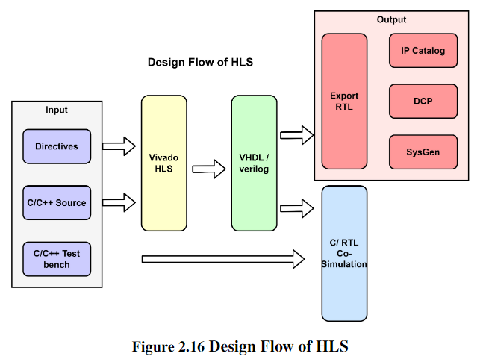
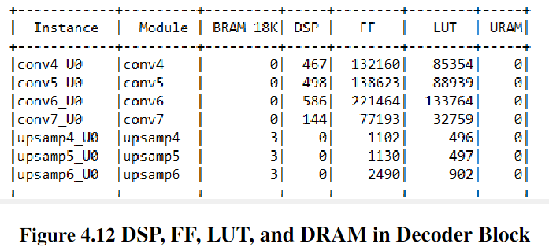
2
High level implementation using C/C++
5

Slide 7
2
High level implementation- Fix pointed
Set interger bits in layers
Resources used corresponding with bit width
Layer | ConV1 | Pool1 | Conv2 | Pool2 | Conv3 | Pool3
Range (min) | -1.51 | 0 | -4.43 | 0 | -1.15 | 0
Range (max) | 1.12 | 1.15 | 0.99 | 3.13 | 0.83 | 6.64
Interger bit | 3 | 3 | 4 | 3 | 3 | 4
Bit width | PSNR | FF | LUT | DSP | Latency (ms)
32 | 68.1 | 410249 | 458106 | 6172 | 0.155
31 | 68.2 | 379368 | 427192 | 5126 | 0.155
30 | 67.6 | 347151 | 392675 | 4577 | 0.155
29 | 65.4 | 338699 | 356504 | 3822 | 0.150
28 | 64.5 | 308463 | 292575 | 3194 | 0.150
27 | 64.1 | 261412 | 231142 | 2256 | 0.150
26 | 63.4 | 232594 | 184695 | 1975 | 0.150
25 | 63.4 | 217641 | 160482 | 1723 | 0.150
24 | 62.8 | 170542 | 111408 | 1611 | 0.150
Conv4 | Upsa4 | Conv5 | Upsa5 | Conv6 | Upsa6 | Conv7
-2.16 | 0 | -0.74 | 0 | -1.9 | 0 | 0.66
5.67 | 5.67 | 1.15 | 7.86 | 19.51 | 19.51 | 0.98
4 | 4 | 3 | 4 | 3 | 3 | 4
ZCU 104 | Available | 460800 | 230400 | 1728
 | Utilization (%) | 37 | 48 | 93
6

Slide 8
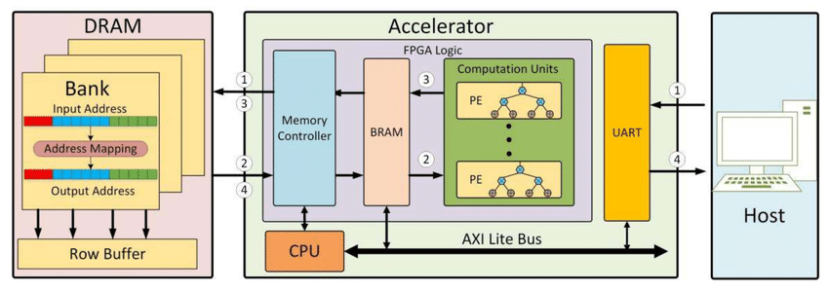
3
Hardware Architecture
5

Slide 9
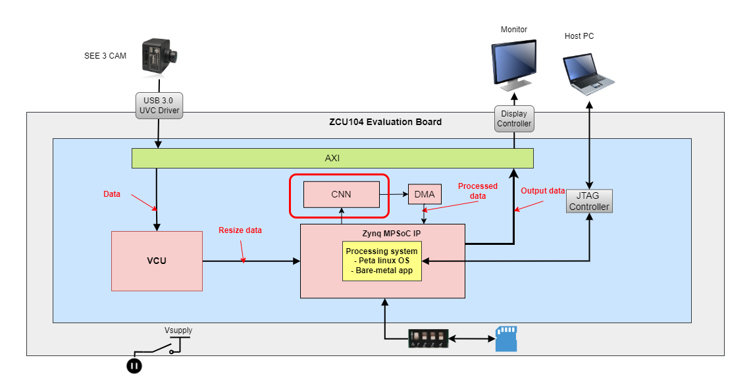
3
SoC block
Saved data
Sd card
7

Slide 10
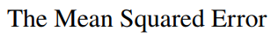
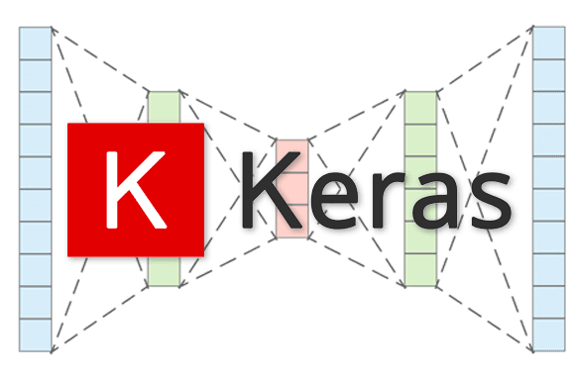
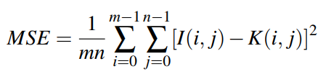
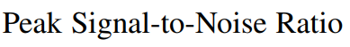
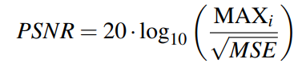
0.0 0.0 0.0 0.000976563 0.0517578 0.431641 0.737305 0.699219 0.40918 0.269531 0.145508 0.140625 0.12207 0.148438 0.100586 0.0458984 0.0234375 0.0351563 0.0458984 0.0136719 0.00488281 0.0 0.0 0.0 0.0 0.0 0.0
4
Result
After Synthesis with 10000 images
MSE = 0.08 PSNR = 66.8 dB
MSE = 0.08 PSNR = 62.8 dB
8

Slide 11
0.0 0.0 0.0 0.000976563 0.0517578 0.431641 0.737305 0.699219 0.40918 0.269531 0.145508 0.140625 0.12207 0.148438 0.100586 0.0458984 0.0234375 0.0351563 0.0458984 0.0136719 0.00488281 0.0 0.0 0.0 0.0 0.0 0.0
4
Result
8

Slide 12
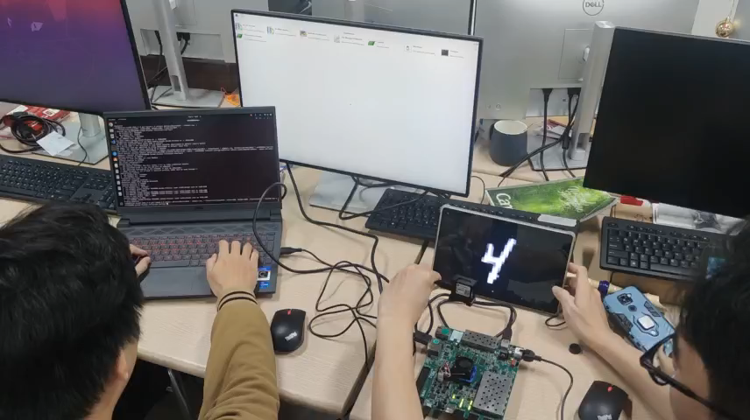
5
Run
9
Notes:
Gen bistream và nạp lên FPGA và kết quả hiện ra

Slide 13
Thank
Thank for listening
9
Notes:
Gen bistream và nạp lên FPGA và kết quả hiện ra

